Slide 1
Area of composite rectilinear shapes
Perimeter and area

Slide 2
how to use Oak lessons

Slide 3
I can find the area of composite rectilinear shapes in different ways.

Slide 4
A composite rectilinear shape is a composite shape made from rectangles.

Slide 5

Area of composite rectilinear shapes
Comparing areas
Three methods to find the area
Evaluating the methods

Slide 6
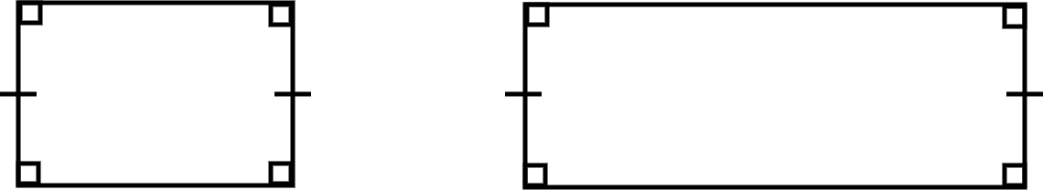
Comparing areas
It is possible to compare the areas of shapes without performing any calculations.
This is done by considering the properties of the shapes.
The two rectangles have the same width but different lengths. The rectangle on the right has the bigger area.

Slide 7
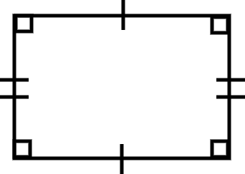
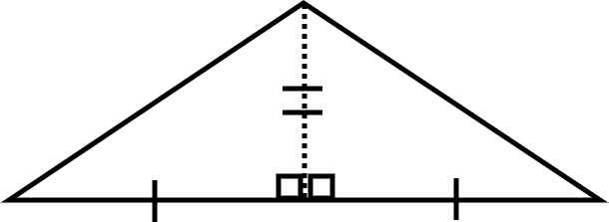
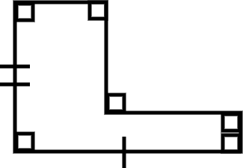
Comparing areas
1) Order the shapes from the smallest to the largest area.
a) b) c)

Slide 8
Comparing areas
1) Order the shapes from the smallest to the largest area.
a) b) c)
C is the smallest as it fits inside A with space left over.
B can be split into two triangles along the dotted line and these can be rearrange to make A. Therefore B and A have the same area.

Slide 9
Comparing areas
The area of a shape can be calculated by splitting the shape up and calculating the area of each part.

Slide 10
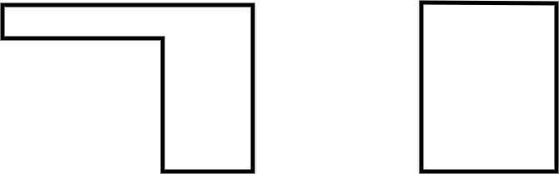

Comparing areas
The area of shape A is the area of shape B.
Shape A Shape B.
14
larger than
2
9
9
9
smaller than
7
5
7
the same as

Slide 11
Area of composite rectilinear shapes
Comparing areas
Three methods to find the area
Evaluating the methods

Slide 12
Three methods to find the area
A composite rectilinear shape is made of rectangles, so we can break it up into rectangles.

Slide 13
Three methods to find the area
In what ways might we break up this shape to find the area?

Slide 14
Three methods to find the area
In what ways might we break up this shape to find the area?

Slide 15
Three methods to find the area
In what ways might we break up this shape to find the area?

Slide 16
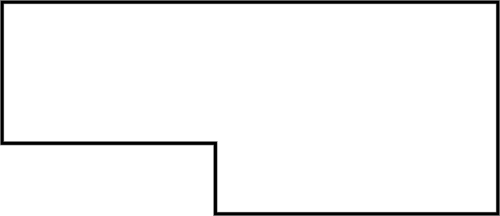
Three methods to find the area
A composite rectilinear shape is made of rectangles, so we can break it up into rectangles.
7 units
2 units
3 units
3 units
1 unit
4 units

Slide 17
Three methods to find the area
Breaking into rectangles
Breaking into rectangles
7 units
7 units
2 units
2 units
3 units
3 units
3 units
1 unit
3 units
1 unit
4 units
4 units
Area = 2 × 3 + 4 × 3
Area = 6 + 12
Area = 18 units²
Area = 2 × 7 + 4 × 1
Area = 14 + 4
Area = 18 units²

Slide 18
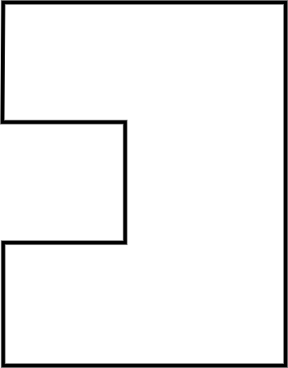
Three methods to find the area
An alternative method is to complete the rectangle.
7 units
Area = 7 × 9 - 3 × 3
Area = 63 - 9
Area = 54 units²
9 units
3 units
3 units

Slide 19
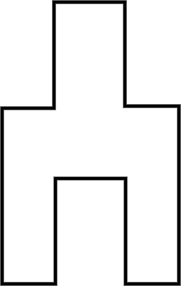
Three methods to find the area
We can also rearrange into a rectangle.
2 units
3 units
Area = 5 × 7
Area = 35 units²
2 units
5 units
3 units
7 units

Slide 20
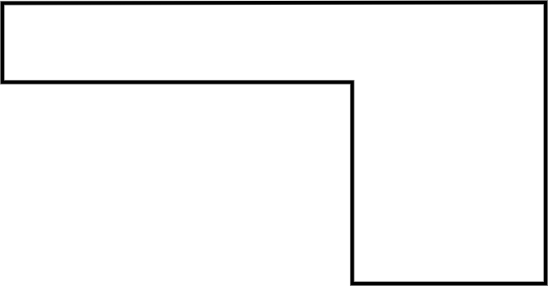
Three methods to find the area
1) Calculate the area of this composite rectilinear shape using each of the three methods.
Which is most efficient?
Justify your choice.
9 units
14 units
7 units
9 units
2 units
5 units

Slide 21
Three methods to find the area
1) Calculate the area of this composite rectilinear shape using each of the three methods.
Which is most efficient?
Justify your choice.
9 units
14 units
7 units
9 units
2 units
5 units

Slide 22
Three methods to find the area
14 units
9 units
E.g.
Area = 2 × 9 + 5 × 9
Area = 18 + 45
Area = 63 units²
7 units
2 units
9 units
5 units
E.g. I think this method is the most efficient as it is the one I find the easiest to do. This method is easy to always do.

Slide 23
Three methods to find the area
14 units
9 units
7 units
Area = 14 × 9 - 7 × 9
Area = 126 - 63
Area = 63 units²
2 units
9 units
5 units
E.g. I think this method is the most efficient as it involves less work when the composite rectilinear shape is more complicated.

Slide 24
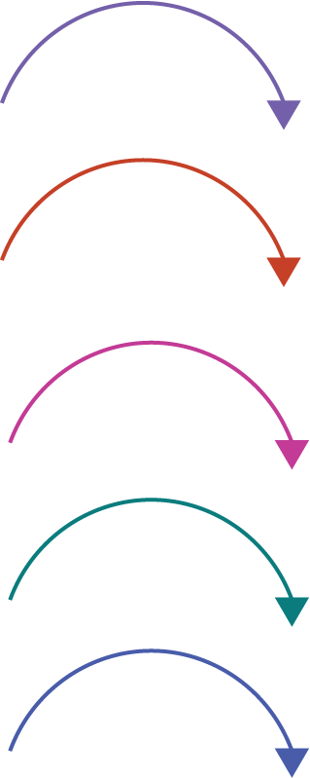
Three methods to find the area
14 units
9 units
7 units
Area = (2 + 5) × 9
Area = 7 × 9
Area = 63 units²
2 units
9 units
5 units
E.g. I think this method is the most efficient as it made just one rectangle that I had to find the area of.

Slide 25
Area of composite rectilinear shapes
Comparing areas
Three methods to find the area
Evaluating the methods

Slide 26
Evaluating the methods
Here is the working from the three methods:
2 × 9 + 5 × 9 = 63 units²
14 × 9 - 7 × 9 = 63 units²
(2 + 5) × 9 = 63 units²
2 × 9 + 5 × 9 = 7 × 9
14 × 9 - 7 × 9 = 7 × 9
(2 + 5) × 9 = 7 × 9
14 units
9 units
7 units
2 units
9 units
5 units

Slide 27
Evaluating the methods
Different methods give different answers.
You can use any method but some may be easier, depending on the shape.

Slide 28
Evaluating the methods
1) Draw your own composite rectilinear shape and try to find the area using the three methods.
Can you draw a shape where one (or more) of these methods would not be helpful?

Slide 29
Evaluating the methods
1) Draw your own composite rectilinear shape and try to find the area using the three methods.
Can you draw a shape where one (or more) of these methods would not be helpful?

Slide 30
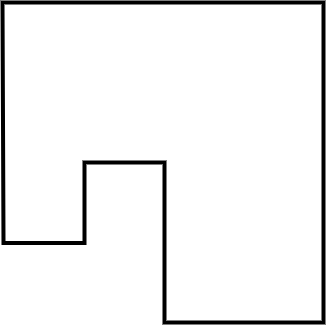
Evaluating the methods
Shapes will vary but should all be built from rectangles placed adjacent.
Here is an example of a shape where completing and rearranging are not as helpful.

Slide 31
Area of composite rectilinear shapes
A composite rectilinear shape is made of rectangles.
The area of a composite rectilinear shape can be found in different ways.
Depending on the shape, a particular method may be more useful than the others.

Slide 32

© Oak National Academy 2024.
Produced in partnership with Mathematics in Education and Industry.
Licensed on the Open Government Licence v3.0, except where otherwise stated. See Oak terms and conditions.

